Slide 1
Knowledge Representation and Logic by
Seyed Abolghasem Mirroshandel mirroshandel@gmail.com
Notes:
Fall 98

Slide 2
Outline
Motivation
Knowledge bases and inferences
Logic as a representation language
Propositional logic

Slide 3
Motivation (1)
Up to now, we concentrated on search methods in worlds that can be relatively easily represented by states and actions on them
  a few objects, rules, relatively simple states
  problem-specific heuristics to guide the search
  complete knowledge: know all what’s needed
  no new knowledge is deduced or added
  well-defined start and goal states
Appropriate for accessible, static, discrete problems.

Slide 4
Motivation (2)
What about other types of problems?
  More objects, more complex relations
  Not all knowledge is explicitly stated
  Dynamic environments: the rules change!
  Agents change their knowledge
  Deduction: how to derive new conclusions
Examples
  1. queries on family relations
  2. credit approval
  3. diagnosis of circuits

Slide 5
Example 1: family relations
Facts:
  Sarah is the mother of Tal and Mor
  Moshe is married to Sarah
  Fanny is the mother of Gal
Query: Is Moshe the father of Tal?
Deduction:
  people have a mother and a father
  Moshe is married to Sarah, who has 2 children
  Sarah’s children are Moshe’s children (no divorce)
New knowledge deduced, assumptions apply!

Slide 6
Example 2: credit approval
Facts
  Moshe is employed for 5 years and earns 10,000$ a month.
  Credit approval rules: must be employed at least 3 years, earn at least 5,000 $, have no outstanding debits.
Query: is Moshe eligible for credit?
Decision procedure:
  build a decision tree procedural
  check the rules declarative
Advantages and disadvantages of each.

Slide 7
Example 3: circuit diagnosis
Facts:
  circuit topology, components, inputs/outputs
  component and connection rules
  faulty output for given input
Query: What are the components that are likely to be faulty?
Deduction:
  classify all possible faults and their explanation
  deductive process for fault detection

Slide 8
Procedural vs. Declarative knowledge
Procedural: how to achieve a goal, procedure to answer queries
  hard wired, efficient, specific to a problem and situation; difficult to change and update.
Declarative: relations that hold between entities + general inference mechanism
  more general: decouples knowledge from deduction, easier to update, possibly less efficient
We will focus on declarative representations.

Slide 9
Knowledge base architecture
Updates
KNOWLEDGE
BASE (KB)
facts and rules
Query
Answer
INFERENCE MECHANISM
Note: compare with problem solving as search

Slide 10
Knowledge base issues
Representation language:
  how expressive is it? What can and cannot be said?
Inference procedure: general procedure to derive new conclusions
  Is it sound? Do all conclusions follow rationally from the facts and rules?
  Is it complete? If a conclusion rationally follows from the KB, can I deduce it?
  Is it efficient? Does it take time polynomial in the number of facts and rules?

Slide 11
The world, its representation, and its implementation
FOLLOWS
Facts ==> Facts
microworld
Domain Model
INFERENCE
representation
Sentences ==> Sentences
Axiomatic System
implementation
Computer representation

Slide 12
Domain model
Specifies how the microworld will be modeled
Ontology: microworld we are modeling.
  Family relations between individuals
Domain theory: type of facts and relations
  persons: sarah, tal, mor
  relations: mother_of, married, …
A fact is true if it follows from a set of facts based on rational arguments

Slide 13
Representation language
Formal language to represent facts and rules about a microworld as sentences.
Interpreted sentences represent a model of the microworld
Syntax: how sentences formed
  mother_of(sarah,tal) /\ mother_of(sarah,mor)
Semantics: how to interpret sentences True/False
Set of all sentences (axioms, rules) is the abstract representation of the KB

Slide 14
KB Inference procedure
Works on the syntactic representation of sentences: a => b and a, deduce b
Independent of the meaning (semantics) of the knowledge represented
Captures a subset of rational rules of thought
  modus ponens, entailment, resolution.
Note: these inference rules are different from the KB rules!
Base sentences are called axioms, derived sentences theorems, derivations proofs.

Slide 15
Implementation
How sentences are represented in the computer: data structures for facts and relations.
How to perform inferences based on abstract inference procedure rules.
Typical procedures:
  pattern matching
  knowledge base management

Slide 16
Logical Theory Structure
Domain
Model
Axiomatic
System
Implementation
Formal
semantics
Ontology
Formal
Language
Data
Structures
Definition
Describes
Stated
in
Operates
on
Domain
Theory
Axioms
Procedures
Justified by
Justified by

Slide 17
Example: family relations
Ontology: family relations microworld
Domain theory: sarah, tal, mother_of relation,
Formal language: first order logic
Axioms:
  mother_of(sarah,tal), ….
  ∀X, ∃Y mother_of(Y,X), …..
Data structures: functions, structs, lists
Procedures: matching, rule ordering, ...

Slide 18
Logic and knowledge representation (1)
Mathematical logics have well-defined syntax, semantics, and models:
  Propositional: facts are True/False
  First Order: facts, objects, relations are True/False
  Temporal logic: First Order + time
  Probability theory: facts, degree of belief [0…1]
Interpretation: truth assignment to each element on the formula A is True

Slide 19
Logic and knowledge representation (2)
A sentence is
  valid (a tautology) if it is true for any truth assignement (A \/ ~A)
  satisfiable if there exists a truth assignment that makes it true (A /\ B)
  unsatisfiable if there is no truth assignment that makes it true (A /\ ~A)
  model of a sentence is an interpretation that satifies the sentence
Inference rules: modus ponens, deduction

Slide 20
Logic: notation and properties
KB |= c c logically follows from KB
KB |=_{R} c c follows from KB using rules R
|= c c is a tautology
Soundness and completeness of R KB |= c iff KB |=_{R}c
Monotonicity if KB₁ |= c then (KB₁ U KB₂) |= c
Note: distinguish with KB |-- c, S => c

Slide 21
Propositional Logic -- Syntax
Facts, boolean relations between them, True/False truth assignements to boolean sentences
SYNTAX:
Sentence ----> Atomic_Sentence | Complex_Sentence
Atomic_Sentence ----> True | False | P | Q | R …
Complex_Sentence ----> (Sentence) | ~Sentence
Sentence Connective Sentence
Connective -----> /\ | \/ | => | <=> | ….

Slide 22
Propositional Logic -- Semantics
Recursively defined by the truth value of atomic sentences. Boolean truth tables for each connective and for ¬
The validity of a sentence is determined by constructing a truth table
  ((P \/ Q) /\ ~Q) => P
P Q P /\ Q P \/ Q
False False False False
False True False True
True False False True
True True True True

Slide 23
Validity by truth-table construction

Slide 24
Proof methods
Given a knowledge base KB = {S₁, S₂,∧…∧ , S_{n}} and a sentence c, determine if c logically follows from KB: KB |= c
Two proof methods
  use inference rules R to determine if KB |=_{R} c
  build a truth table to test the validity of the sentence (S₁ /\ S₂/\ …/\ S_{n}) => c

Slide 25
Models and Inferences
Any world in which a sentence S is true under a particular interpretation is called a model of that sentence under that interpretation.
Rules of inference: extension of truth-tables to capture patterns (classes of inferences) that are used frequently and whose soundness we can established once and for all.
In the following table, a, b, a_{i}, etc represent sentence patterns: they can be matched to specific sentences

Slide 26
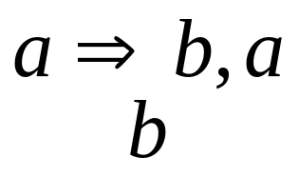
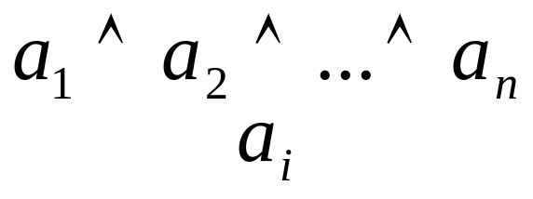
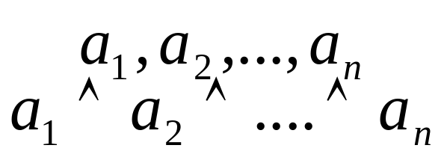
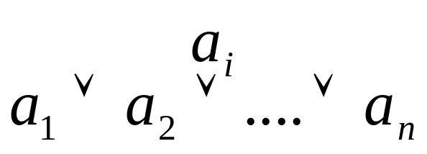
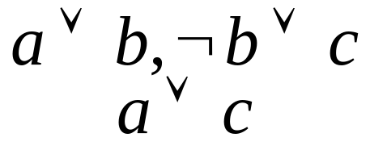
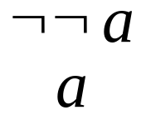
Propositional Logic -- Inference Rules
Modus Ponens
And-Elimination
And-Introduction
Or-Introduction
Resolution
Double negation

Slide 27
Propositional logic example (1)
Given: “Heads I win, tails you lose”
Prove: “I always win”
Propositions: heads, tail, winme, looseyou
Axioms:
  1. heads => winme heads I win
  2. tails => looseyou tails you lose
  3. heads \/ tails either heads or tails
  4. loseyou => winme you lose I win

Slide 28

Propositional logic example (2)
  1. ~heads \/ winme
  2. ~tails \/ loseyou
  3. heads \/ tails
  4. ~loseyou \/ winme
Resolution: a \/ b, ~b \/ c a \/ c
1’ (1,3) tails \/ winme
2’ (2,4) ~tails \/ winme
3’ (1’,2’) winme \/ winme
3” winme

Slide 29
Inference as Search
Search method: Given a knowledge base with sentences, apply inference rules until the query sentence is generated. If it is not generated, then it cannot be inferred
  state: a conjunction of sentences in the KB
  start: initial KB
  Goal: KB containing the query sentence
  Inference rules: the ones above
Are all inferences sound? Are the inference rules complete? What is their complexity?

Slide 30
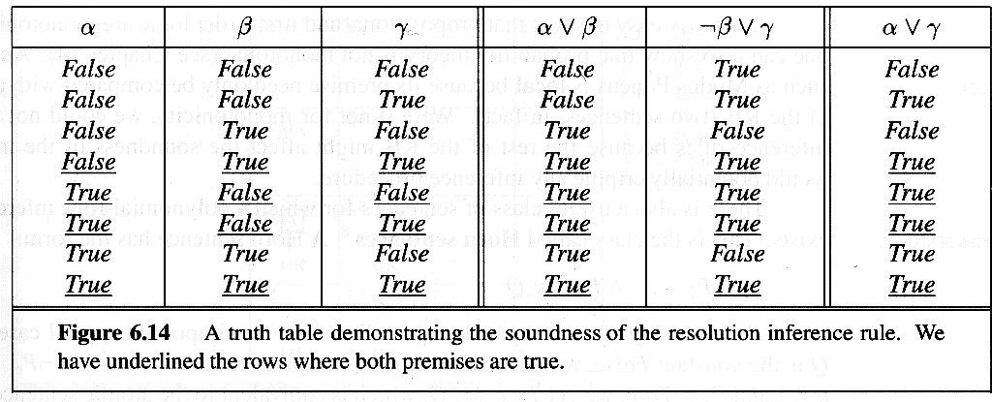
Soundness of Inference Rules
The conclusions obtained by applying
inference rules are logically valid.
Proof by truth table for each inference rule
Example: Modus Ponens

Slide 31
Completeness of Inference Rules
The inference rules are complete iff all sentences that follow logically from KB can be derived by the rules.
The rules are refutation-complete: tautologies such as (P \/ ~P) cannot be derived. Instead, prove that the negation of the sentence yields a contradiction.
Proof procedure: add the negation of the conclusion, apply the rules. If a contradiction is derived, the conclusion is true (ex: “Tails…”)

Slide 32
Decidability and complexity
Propositional logic is decidable: there exists a computational procedure to decide if a sentence logically follows from a set of axioms
Complexity: exponential in the number of propositions. Proof by reduction to satifiability problem:
  (a \/ ~b \/ c) /\ (c \/ ~d \/ e) ….
  for the restricted Horn type (at most one negation) polynomial time procedure

Slide 33
Truth-table inference method
Let KB = {S₁, S₂,∧…∧ , S_{n}} be a set of sentences and c a possible conclusion
C logically follows from KB iff the sentence S₁ /\∧S₂∧/\ …∧/\ S_{n} => c is a tautology
Complexity: exponential in the number of propositions!

Slide 34
Truth-table method: example
winme looseyou heads tails 1 2 3 4 (1,2,3,4) S =>winme
0 0 0 0 1 1 0 1 0 1
0 0 0 1 1 0 1 1 0 1
0 0 1 0 0 1 1 1 0 1
0 0 1 1 0 0 1 1 0 1
0 1 0 0 1 1 0 0 0 1
0 1 0 1 1 1 1 0 0 1
0 1 1 0 0 1 1 0 0 1
0 1 1 1 0 1 1 0 0 1
1 0 0 0 1 1 0 1 0 1
1 0 0 1 1 0 1 1 0 1
1 0 1 0 1 1 1 1 1 1
1 0 1 1 1 0 1 1 0 1
1 1 0 0 1 1 0 1 0 1
1 1 0 1 1 1 1 1 1 1
1 1 1 0 1 1 1 1 1 1
1 1 1 1 1 1 1 1 1 1

Slide 35
Expressiveness of Propositional Logic
Cannot express general statements of the form “every person has a father and a mother”
Must list all specific instances:
  father_of(moshe, tal), father_of(moshe,mor)….
  Which usually yields many sentences...
Extend the language to represent objects and relations between objects: First Order Logic
  ∀X ∃Y, Z such that father(Y,X) and mother(Z,X)

